Slide 1

Covert Channels: A Window of Data Exfiltration Opportunities
Joel Oseiga Aleburu

Slide 2
CONTENTS OF THIS TALK
Here’s how this talk would go:
About the speaker
Basic Preamble Information
What are covert channels
How Covert Channels work (With a Demo)
Known Implementations
How to Detect
Questions

Slide 3
What I do
Education
01
03
Interests
Other Stuff
02
04
About The Speaker
IT Security Architect
Msc. Cyber Security- University ofYork
Bsc. Computer Science- Bowen
Critical Systems, SCADA
NSA and Cyber Warfare
Small Towns, Skydiving, Small planes and Fast cars ☺
This is my first talk ever

Slide 4
Covert Channels
Clever misuse of legitimate, existing channel
Easy to design and nearly undetectable
Perfect for patient long term data exfiltration
Not a commonly used technique
Bypass security or policy by compromised/malicious computer processes
Evade Surveillance
Bypass Communication
Etc.

Slide 5
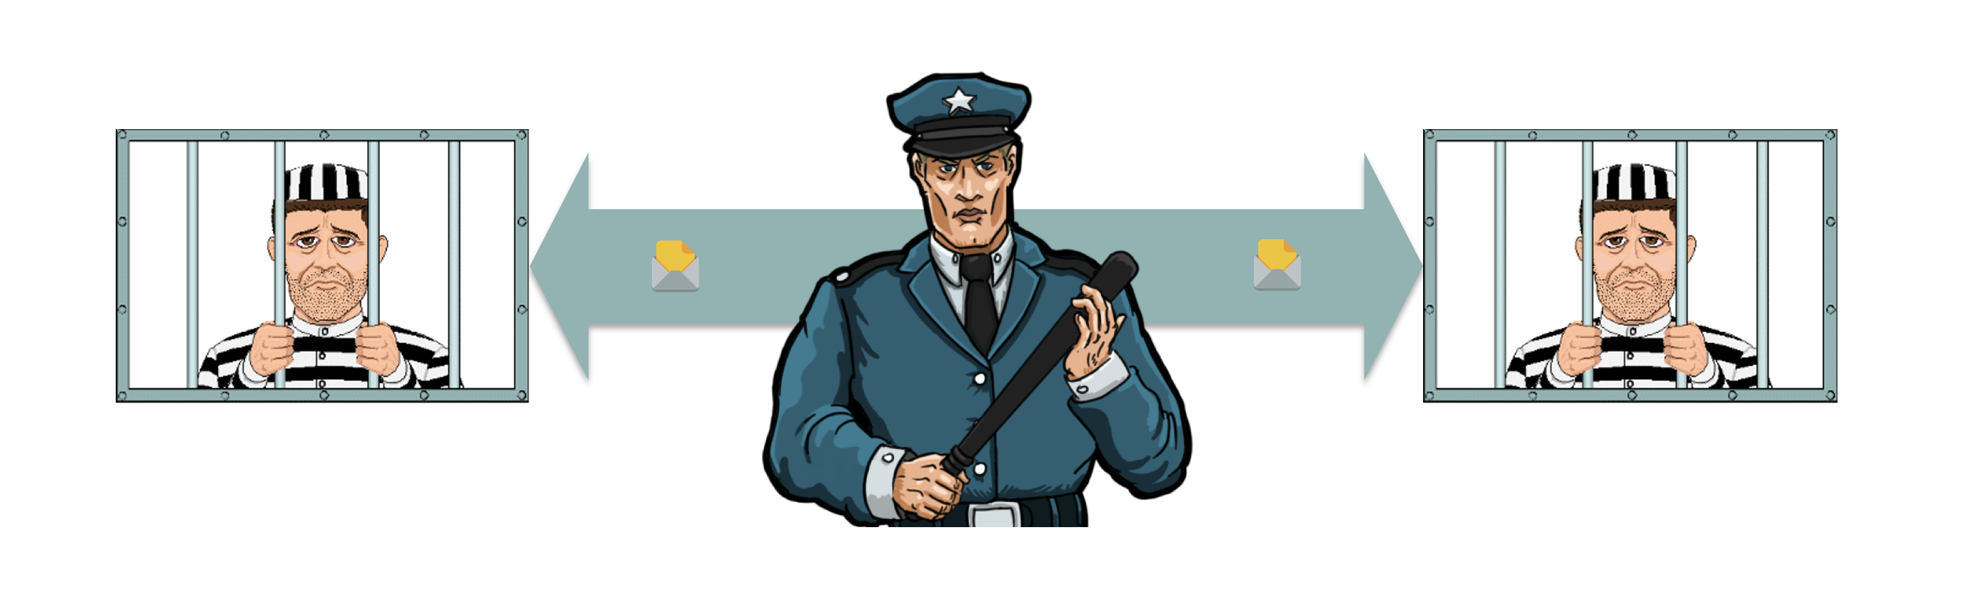
Prisoner’s Dilemma
How can Prisoner A and B plan their escape with the cop in the middle without getting caught if they are always allowed to talk to each other?
Notes:
Two prisoners locked in two near-by cells are planning their escape. They are allowed to talk with each other, but there’s a jailer who can hear their conversation. Talking with each other is the only way of communication between the two of them, but they need to be careful. If the jailer senses that they are planning for something, he might move them to distant cells, which will jeopardize their escape plan. How can the prisoners plan their escape without making the jailer suspicious?

Slide 6
Preamble Information
Make message unreadable
Hide the message in another message
Hide the message in the career
Key type of data hiding:
Cryptography
Steganography
Metaferography
Find a good covert channel:
Find where random data is transmitted naturally
Ex. Initial sequence numbers, complex timing of network transmissions
`Replace random data with your own ‘random data’ which is an encrypted message
Definition: Communicate information between two computer processes that are not allowed to communicate by hiding information into shared resources
Notes:
Covert channels are not new. Hiding a secret message within a message is a concept that has existed for hundreds of year. In computer network CCs, message hiding relies not on shared complex algorithms or keys to keep the message safe, but pure security through obscurity. It is fundamental to recognize this difference between covert communications and encrypted communications. In the latter, the data stream is ideally unintelligible and irretrievable by an unauthorized party but encrypted communications don’t hide the fact that a communication took place. It is this shortcoming which CCs address; how does one send a message, or exfiltrate data from a secure network, without detection?
As this presentation will outline, there are nearly infinite ways to implement CCs, which makes the technique a formidable one to detect and defend against.

Slide 7
An Example
Alice wants to send a message to Bob
Alice FTPs Bob some old vacation pictures, meanwhile Bob records all traffic
Alice encodes the secret message byte by byte in the padding of TCP segment headers
Bob looks at padding of recorded traffic

Slide 8
Classification
Storage Channel
Timing Channel
Data transmitted by writing or abstaining from writing e.g to a ram
Data modulated into the timing or occurrence of events, e.g., the times between network packets
Other types in research:
Temperature based Covert Channels
Hybrid Covert Channels

Slide 9
Classification: Shared Resouces
Network resource:
Computer resource
Existing, legitimate communication channel designed for a purpose
RAM, HardDisk, CPU, etc
Encryption vs Covert?
Big Red flags for the cop with encryption
Resource here:
Timing
E. g., Packet Timing
Storage
E.g., packet headers
“Are you okay? My stomach aches badly. The food was not good”
*345!
Notes:
Let’s say that the prisoners decided to transform their conversation using a secret code, which the jailer is unaware of. This is called “Encryption” in general. In this case, only the two prisoners can translate the transformed messages back to the original because only those two know the secret code used to transform the messages. But, even though the jailer cannot understand the conversation, the inability to understand the conversation could easily make him suspicious. Therefore, Encryption is not the solution for the prisoners’ problem.
Finding a solution to the prisoners’ problem introduces a new way of secret communication called Covert Channels. The goal of a covert channel is to provide communication between two parties in an unusual way so that an intermediate party can hardly notice that there’s such communication.
For example, a covert channel between the two prisoners could be that the number of words in a sentence serves as the actual information to be passed.
e.g: The prisoners can successfully pass the message “345” by using 3 irrelevant sentences as follows.
“Are you okay? I feel like sleeping. The food was not good.”
Are you okay? => 3
I feel like sleeping => 4
The food was not good=> 5
This is a primitive example for a covert channel. But the most important fact is, both entities in the covert channel should understand how it works in order to successfully pass messages.

Slide 10
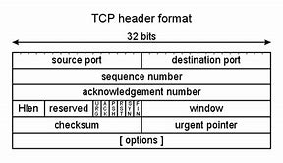
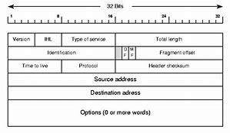
Network Protocol
Network Protocol: Mutual understanding between sender and receiver. Sender sends structured info, receiver interprets
Storage: encode in packet
Timing: Delay packet
Header
Data
Trailer (optional)
*Firewallls snd IDS focus mainly on data
Notes:
A network protocol is basically a contract between a sender and a receiver, where the sender sends structured information in a format that can be interpreted by the receiver. This ‘structure’ of the information is defined as the ‘network packet’ structure. A packet mainly consists of 3 parts which are called the header, data, and an optional trailer. Firewalls and Intrusion Detection Systems (IDS) are particularly interested in the data section of a packet as it carries the actual payload of the transmission.tion is defined as the ‘network packet’ structure.
Storage Channels — Storage Covert channels encode covert data in the packets themselves (encoded in headers as I mentioned before)
Timing (temporal) Channels —Delay between the packets is used to transmit data.
Timing channels are not as reliable as storage channels and are mostly research-oriented. Therefore, during the rest of the article, we’ll be discussing storage covert channels.

Slide 11

DEMO
Store information within TCP header
Program: Covert_tcp
Wireshark
Local machine

Slide 12
Appearance in Pop Culture
Enterprise Data Exfiltration
Firewall Bypass
Eg. Turnelling tcp traffic over ICMP using ptunnel proxy
Most popular- Exfiltrate from protected network
Botnets, backdoors and reverse shells
Some Botnets use protocol channels to shealthily communicate to C&C.
Notes:
Use Cases of Protocol Channels
Enterprise Data Exfiltration — The most popular use case of covert channels is to exfiltrate confidential data out of a protected network.
Bypassing Firewalls to access forbidden content — Covert Channels can also be used to access forbidden content otherwise forbidden by a firewall. An example is tunneling TCP traffic over ICMP using a ptunnel proxy as described at the end of this article.
Botnet Communications, Remote Backdoors, and Reverse Shells — Some Botnets use protocol channels in order to stealthily communicate with their command and control (C&C) centers. Also, remote backdoors or reverse shells can also use covert channels to download additional malicious scripts without detection

Slide 13
Detection and Mitigation
IDS Packet Signatures
Firewall Bypass
Eg. Turnelling tcp traffic over ICMP using ptunnel proxy
To identify packet signatures of common types
Traffic Anomaly Detction
Analyzing packet variation size, header size variation and bandwith use vs time of day
Notes:
Covert Channels can be used with good intent, as well as malicious intent. Therefore, identifying and blocking them is also equally important. Though it is very hard to identify and 100% block covert channels, there are certain ways to make it difficult to set up covert channels.
IDS Packet Signatures— Configuring Intrusion Detection Systems with rules to identify the packet signatures of the common types of covert channels.
Traffic Anomaly Detection — Mostly research-oriented. For example, analyzing packet size variation, header size variation and bandwidth usage vs time of the day can lead to discovering unusual network activities.
Active Warden (Wendzel, Steffen & Keller, Jörg. (2012). Design and Implementation of an Active Warden Addressing Protocol Switching Covert Channels) — A firewall-like service which randomly delays packets if protocol switching is detected, making it hard to establish reliable covert communication. This is useful to prevent protocol switching covert channels.
Packet Data Padding — Intercepting and padding packet header fields which are likely to be used for covert communication.
Still, though, it’s difficult to 100% prevent covert channels without disrupting the legitimate traffic. There’s so much research work done in this area and new types of covert channels and protection mechanisms are invented from time to time.

Slide 14
Detection and Mitigation
Enterprise Data Exfiltration
Firewall Bypass
Eg. Turnelling tcp traffic over ICMP using ptunnel proxy
Most popular- Exfiltrate from protected network
Botnets, backdoors and reverse shells
Some Botnets use protocol channels to shealthily communicate to C&C.
Notes:
Use Cases of Protocol Channels
Enterprise Data Exfiltration — The most popular use case of covert channels is to exfiltrate confidential data out of a protected network.
Bypassing Firewalls to access forbidden content — Covert Channels can also be used to access forbidden content otherwise forbidden by a firewall. An example is tunneling TCP traffic over ICMP using a ptunnel proxy as described at the end of this article.
Botnet Communications, Remote Backdoors, and Reverse Shells — Some Botnets use protocol channels in order to stealthily communicate with their command and control (C&C) centers. Also, remote backdoors or reverse shells can also use covert channels to download additional malicious scripts without detection

Slide 15

THANKS!
Do you have any questions?
joel@smarttech247.com
Please keep this slide for attribution.

